Slide 1
Moorfields
Site Iterations with coordinates
17th Feb 2022

Slide 2
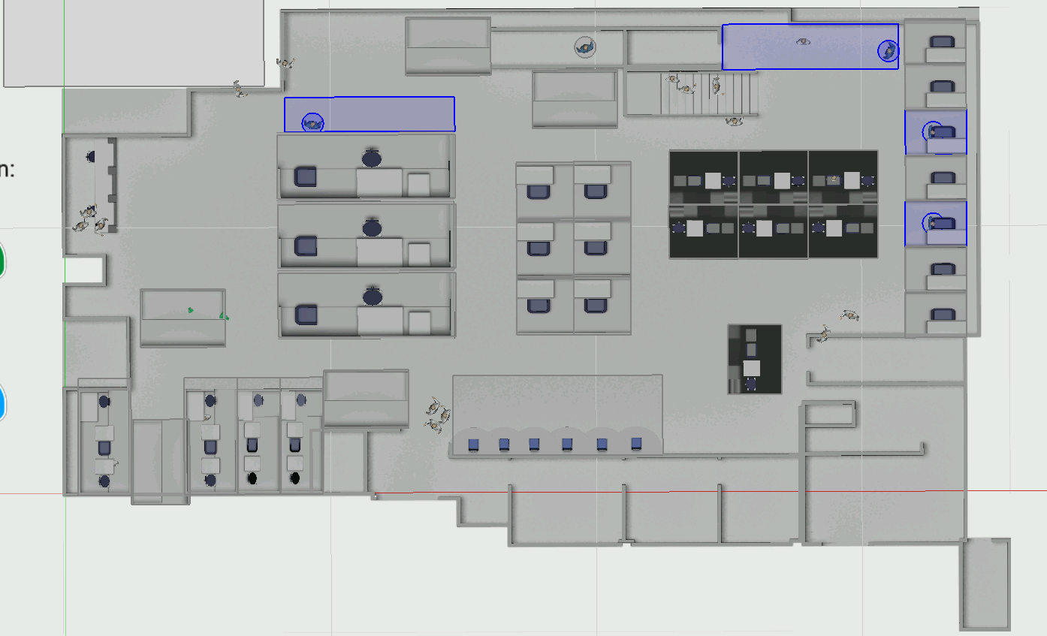
Phase 3 – Current Phase
34.441,18.209 Coordinates
0,0 Coordinates

Slide 3
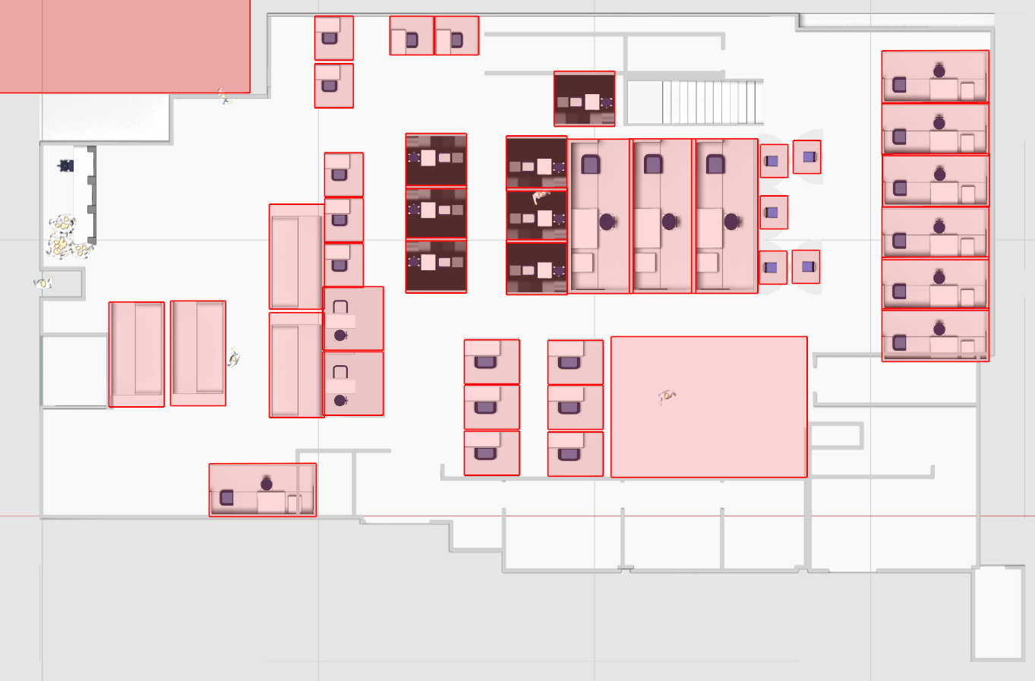
Phase 2
34.441,18.209 Coordinates
0,0 Coordinates

Slide 4
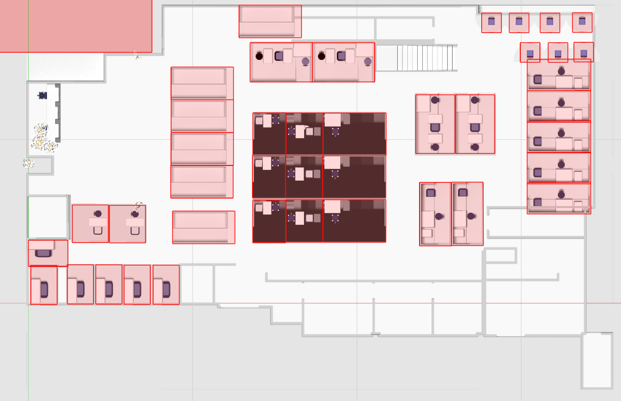
Phase 1
34.441,18.209 Coordinates
0,0 Coordinates

